Slide 1
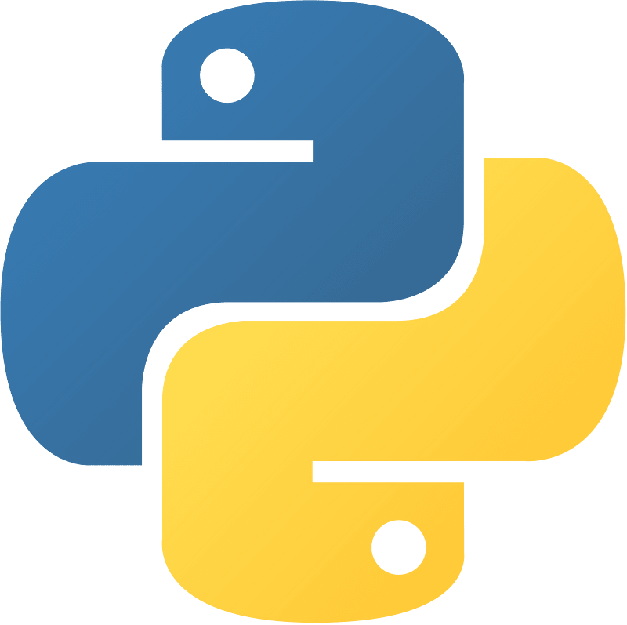
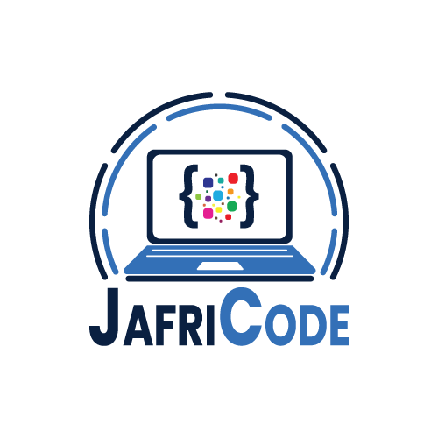
Advanced Python Programming
By: Faisal Zamir
Chapter 07 Advanced Python Libraries and Frameworks
Introduction to popular Python libraries and frameworks
NumPy
Pandas
Matplotlib
Django
Excel
Advanced Python

Slide 2
Advanced Python Programming
By: Faisal Zamir
Chapter 07 Advanced Python Libraries and Frameworks
NumPy: NumPy is a Python library used for scientific computing, which provides support for multi-dimensional arrays and matrices, as well as mathematical operations on them.
Environment Setup: Install NumPy by running "pip install numpy" in your command prompt or terminal.
Why it's used: NumPy is used for numerical computations in scientific computing, machine learning, data analysis, and other fields that require mathematical operations on arrays and matrices.
Advanced Python

Slide 3
Advanced Python Programming
By: Faisal Zamir
Chapter 07 Advanced Python Libraries and Frameworks
Pandas: Pandas is a Python library used for data manipulation and analysis, providing support for data structures such as data frames and series.
Environment Setup: Install Pandas by running "pip install pandas" in your command prompt or terminal.
Why it's used: Pandas is used for data analysis and manipulation tasks such as filtering, sorting, merging, and grouping data, as well as handling missing or duplicate data.
Advanced Python

Slide 4
Advanced Python Programming
By: Faisal Zamir
Chapter 07 Advanced Python Libraries and Frameworks
Matplotlib: Matplotlib is a Python library used for creating visualizations such as graphs, charts, and plots.
Environment Setup: Install Matplotlib by running "pip install matplotlib" in your command prompt or terminal.
Why it's used: Matplotlib is used for creating visualizations to display data in a meaningful way, making it easier to analyze and understand.
Advanced Python

Slide 5
Advanced Python Programming
By: Faisal Zamir
Chapter 07 Advanced Python Libraries and Frameworks
Django: Django is a high-level Python web framework that encourages rapid development and clean, pragmatic design.
Environment Setup: To start using Django, you can install it using pip by running the command "pip install Django" in your command prompt or terminal.
Why it's used: Django is utilized for web development, particularly for building web applications and websites.
Advanced Python

Slide 6
Advanced Python Programming
By: Faisal Zamir
Chapter 07 Advanced Python Libraries and Frameworks
Excel (openpyxl): openpyxl is a Python library for working with Excel files in the .xlsx format. It allows developers to read, write, and manipulate Excel files.
Environment Setup: To use openpyxl, you can install it with pip by running "pip install openpyxl" in your command prompt or terminal.
Why it's used: openpyxl is used for tasks related to Excel file handling and manipulation. It is particularly useful for automating Excel-related operations in Python scripts.
Advanced Python

Slide 7
Advanced Python Programming
By: Faisal Zamir
Chapter 07 Advanced Python Libraries and Frameworks
Different libraries for Excel:
pandas
openpyxl
xlwings
pyxlsb
dataNitro
xlrd
Advanced Python

